Slide 1


FlexJob
Submitted To:
Devang Patel Institute of Advance Technology and Research
Developed By :
Jay Pandya (19dcs074)
Mayank Jadav(19dcs040)
Vivek Mangrola (19dcs057)
Guided By:
Prof. Priyal Vaghela
Prof. Chandrasekar Pawar

Slide 2
CONTENTS
Project Profile
Objective Of Project
Project categories
Environment Description
Implementation Screenshots
Limitations of the project
Project Outcomes
Reference

Slide 3
1. Project Profile
Project Title | Flex Jobs
Project category | Web Development
Front-Hand | HTML, CSS, JAVASCRIPT
Backhand | PHP

Slide 4
2. Objective of project
The main objective for the Flex Job system for the online job seeker are:
To give the company information about the job and task.
High rating profile can get more jobs.
All users can view the all type of jobs.
The site must be easy and flexible to use Navigate must be smoother and company be able to understand the links.
To attract the company by showing your skill the extreme feature, services and hence achieve company satisfaction.

Slide 5
3. Project category
The Flex Job project category is Web Development (website).
The project entitled “Online Job website” the main aim of project is to provide jobs and company information that provided by others. The main theme is to provide jobs.
The process of post a jobs is little because we are allowing an user to post their jobs related information and their work experience. Now you have to select the category of Jobs, pricing and remote work.

Slide 6
4. Environment Description
HARDWARE REQUIREMENTS:
Processor: | I5 5th generation
RAM: | 8gb
SSD: | 128gb
Input Device: | Keyboard, Mouse
Output Device: | Monitor
SOFTWARE REQUIREMENTS:
Operating System: | Any
Front end: | PHP, Java script
Back end: | MySQL 5.0, WAMP or XAMPP sever

Slide 7
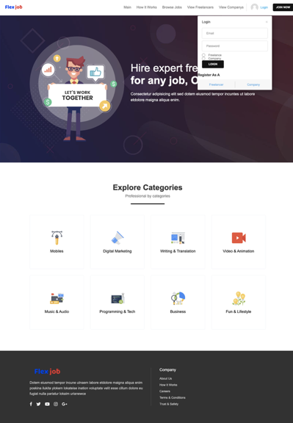
6. Implementation Screenshots
Login

Slide 8
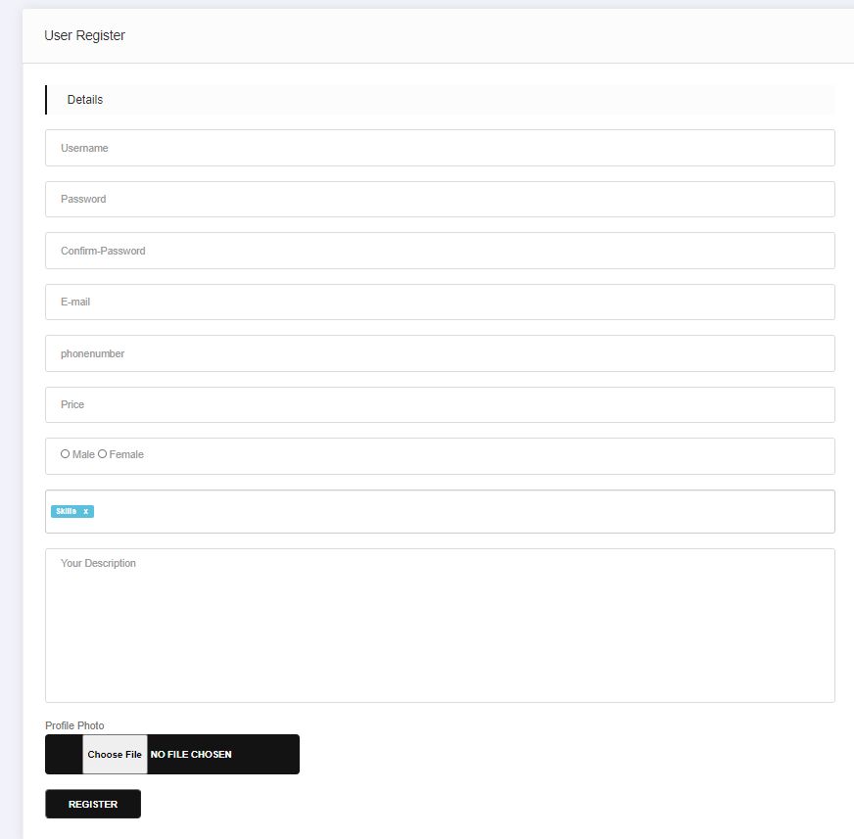
Profile Registration

Slide 9
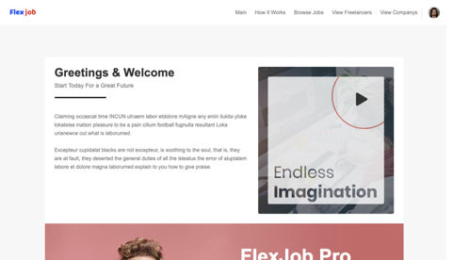
About us

Slide 10
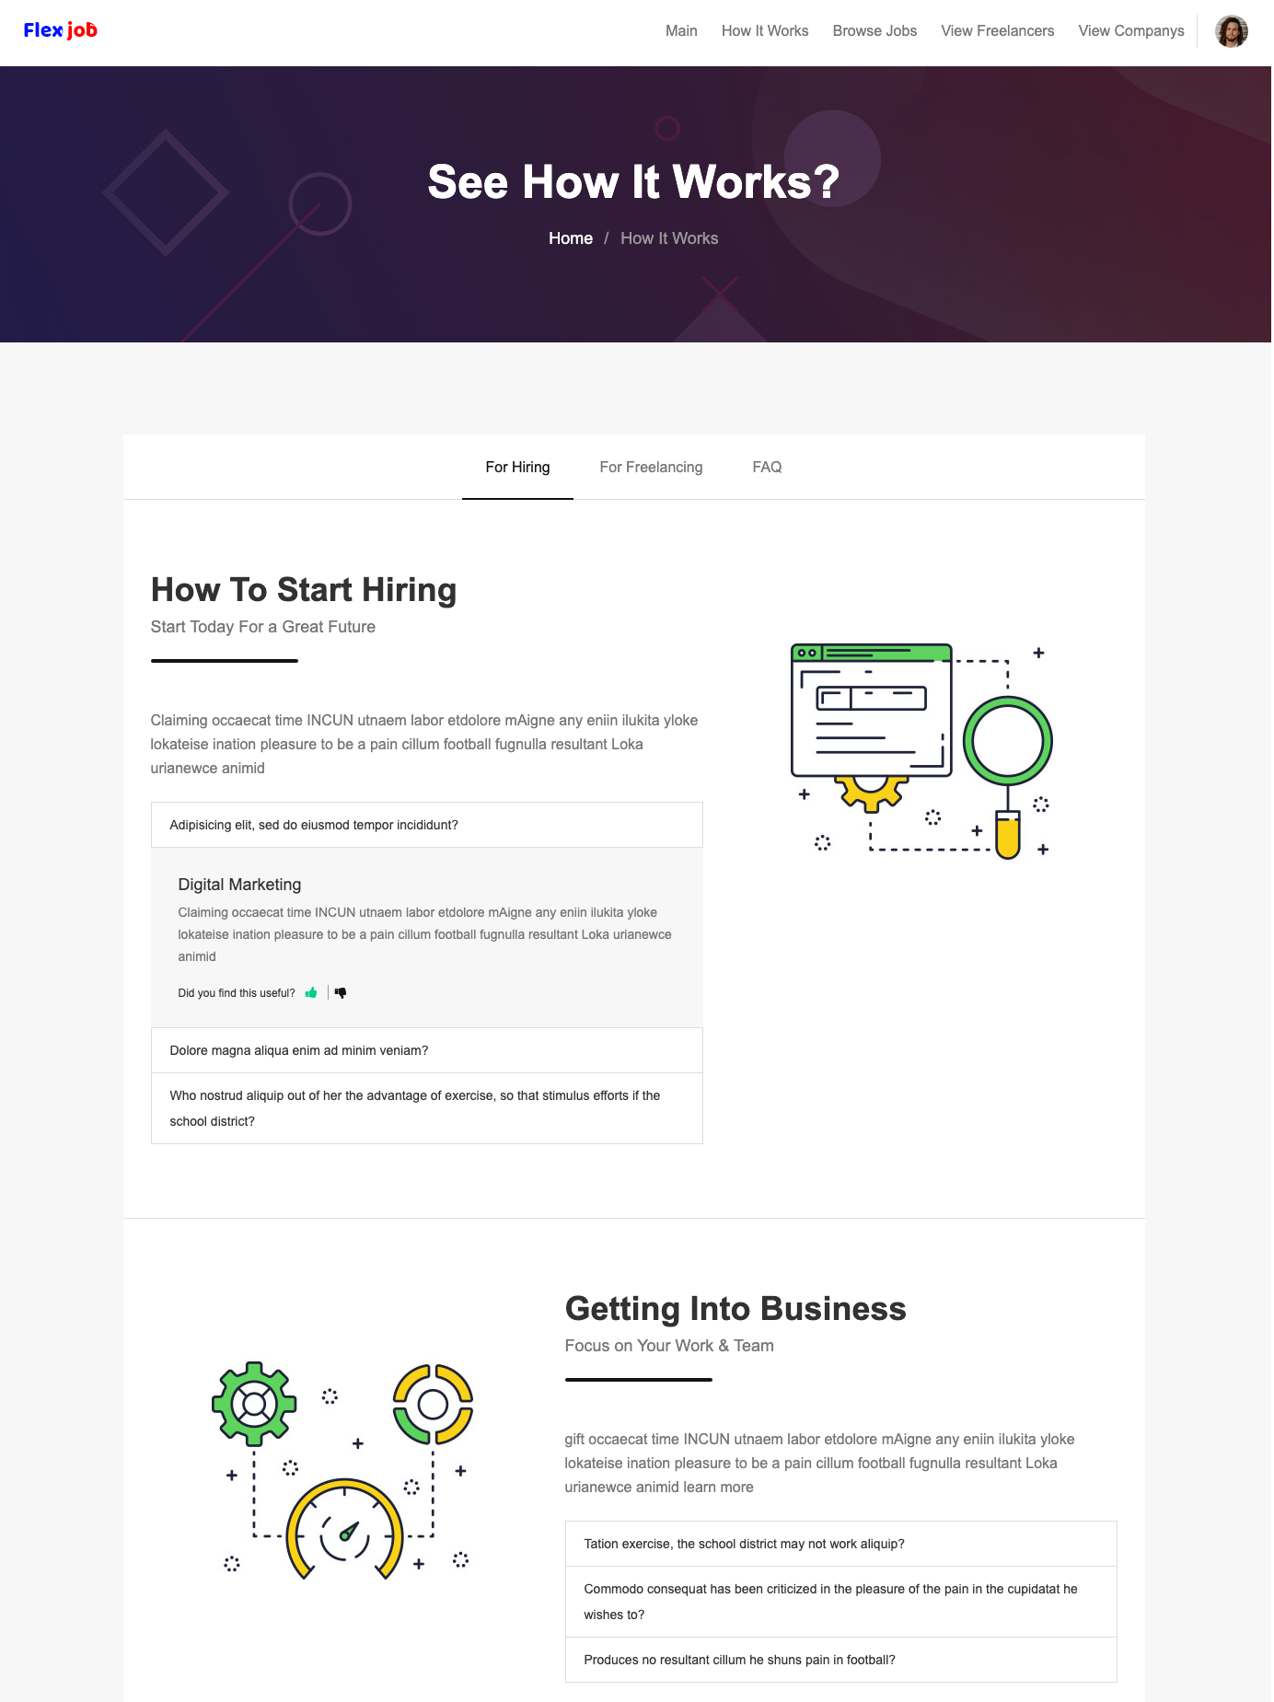
How it works?

Slide 11
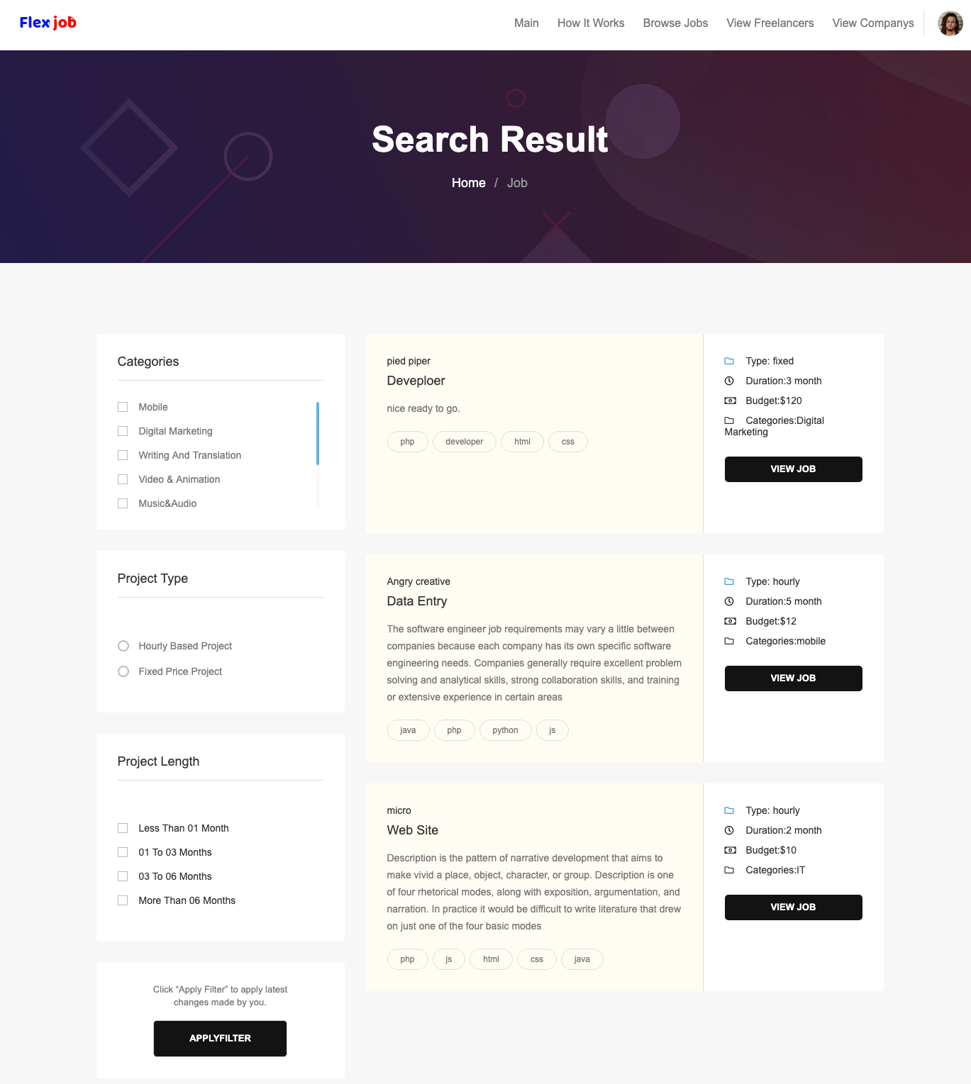
Job lists

Slide 12
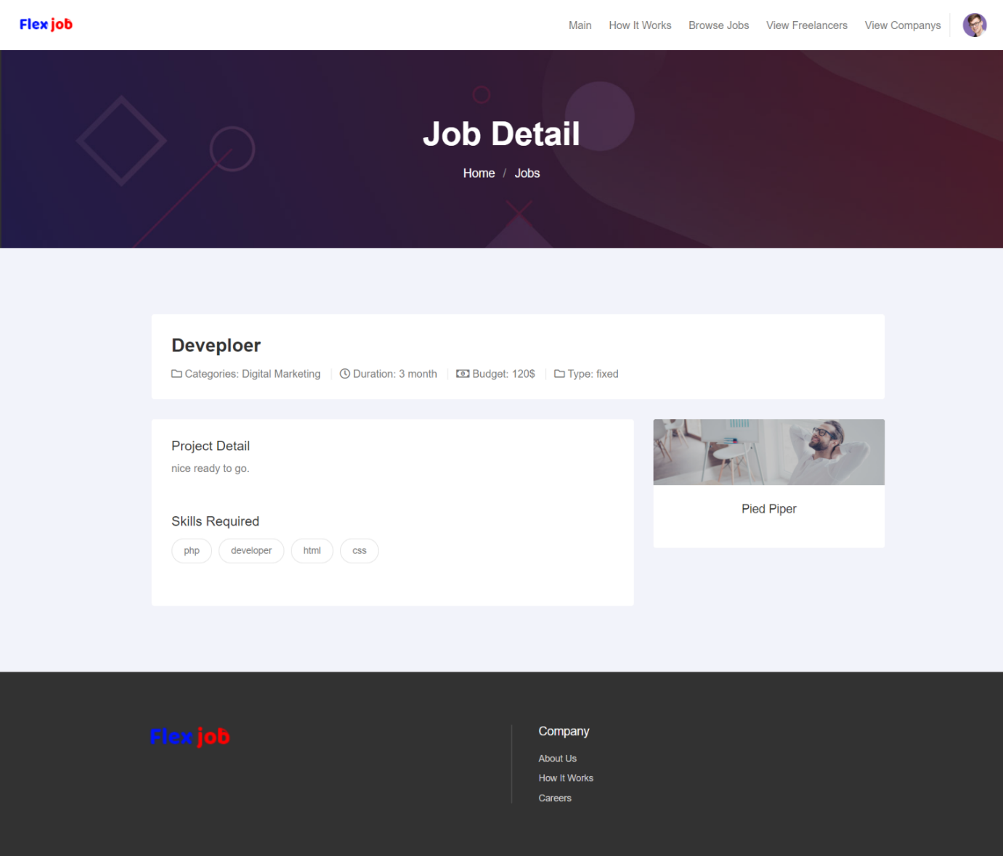
Job Detail

Slide 13
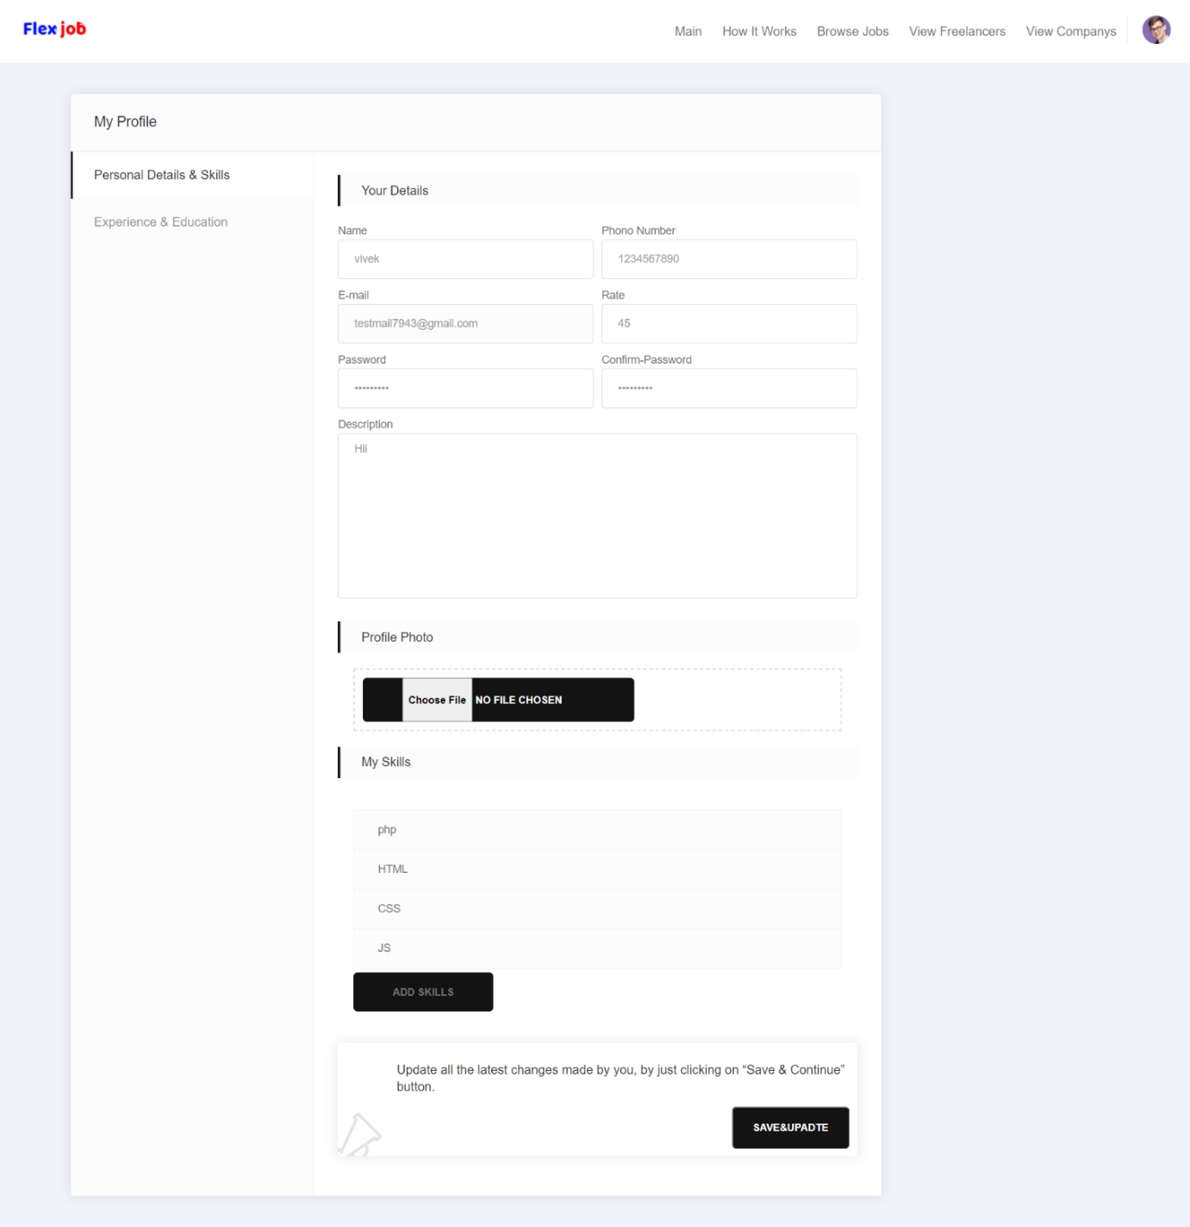
Freelancer Profile Setting

Slide 14
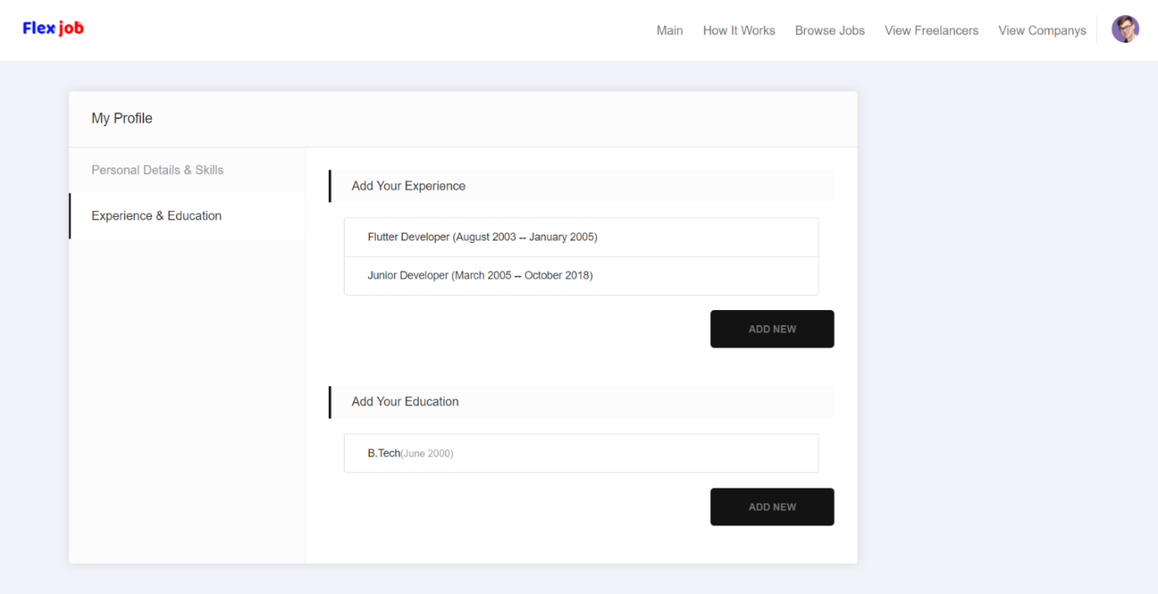
Education and Experience

Slide 15
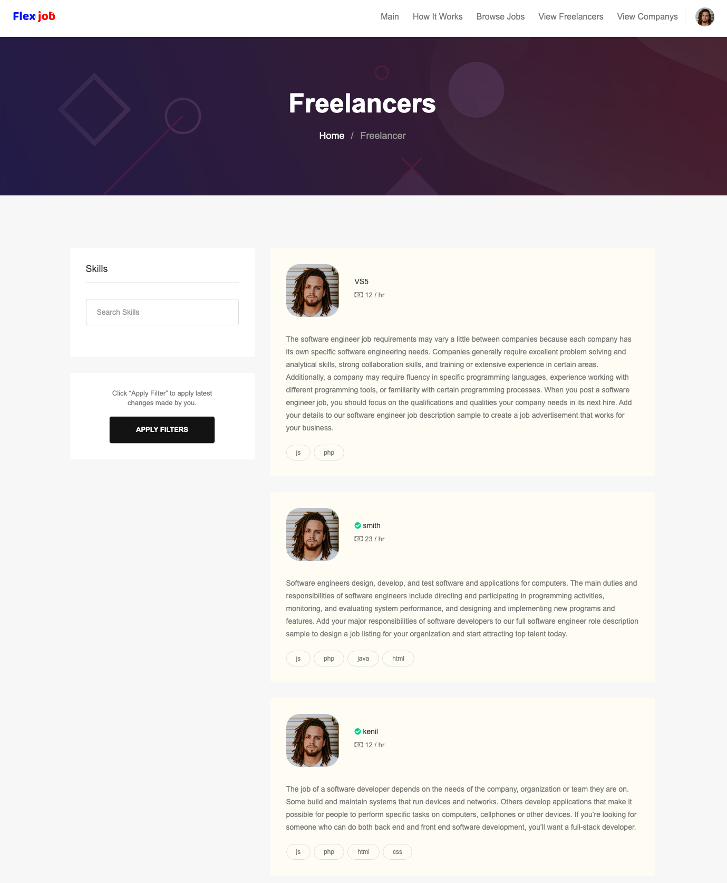
Freelancers List

Slide 16
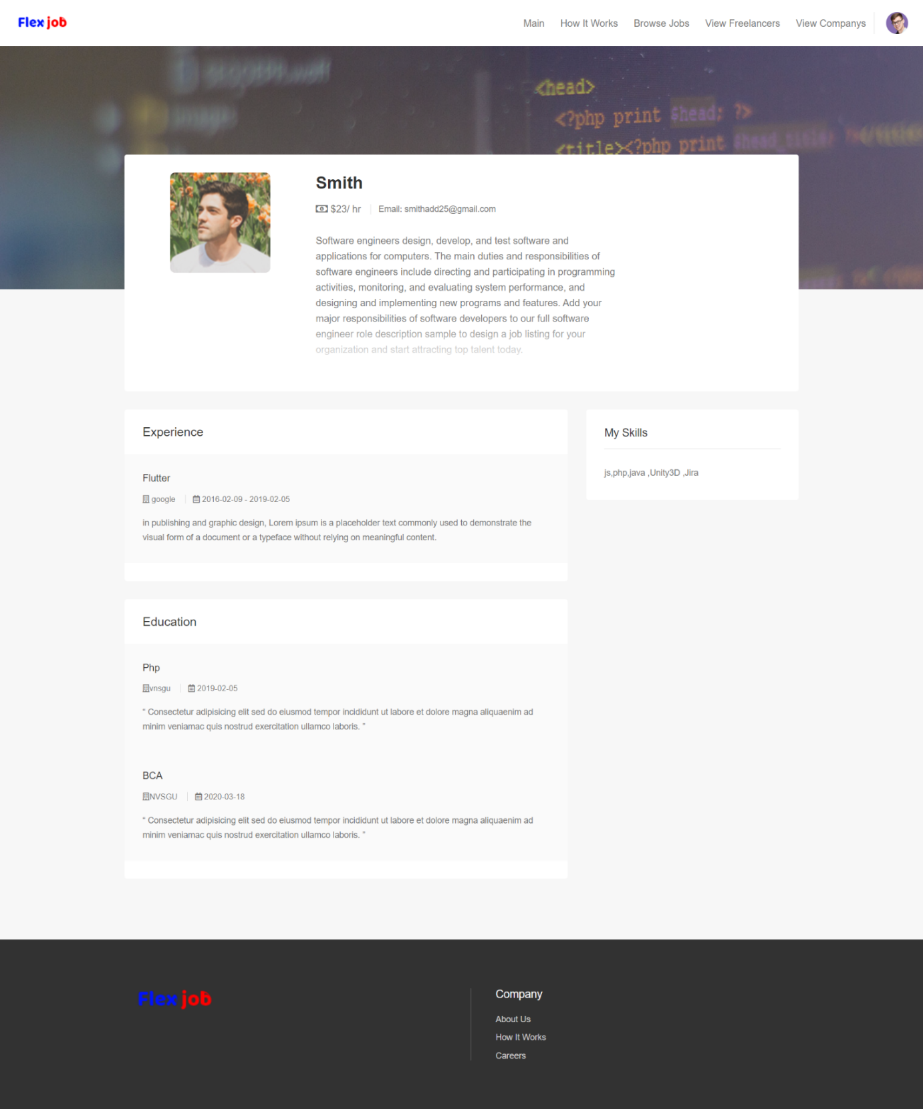
Freelancers Profile

Slide 17
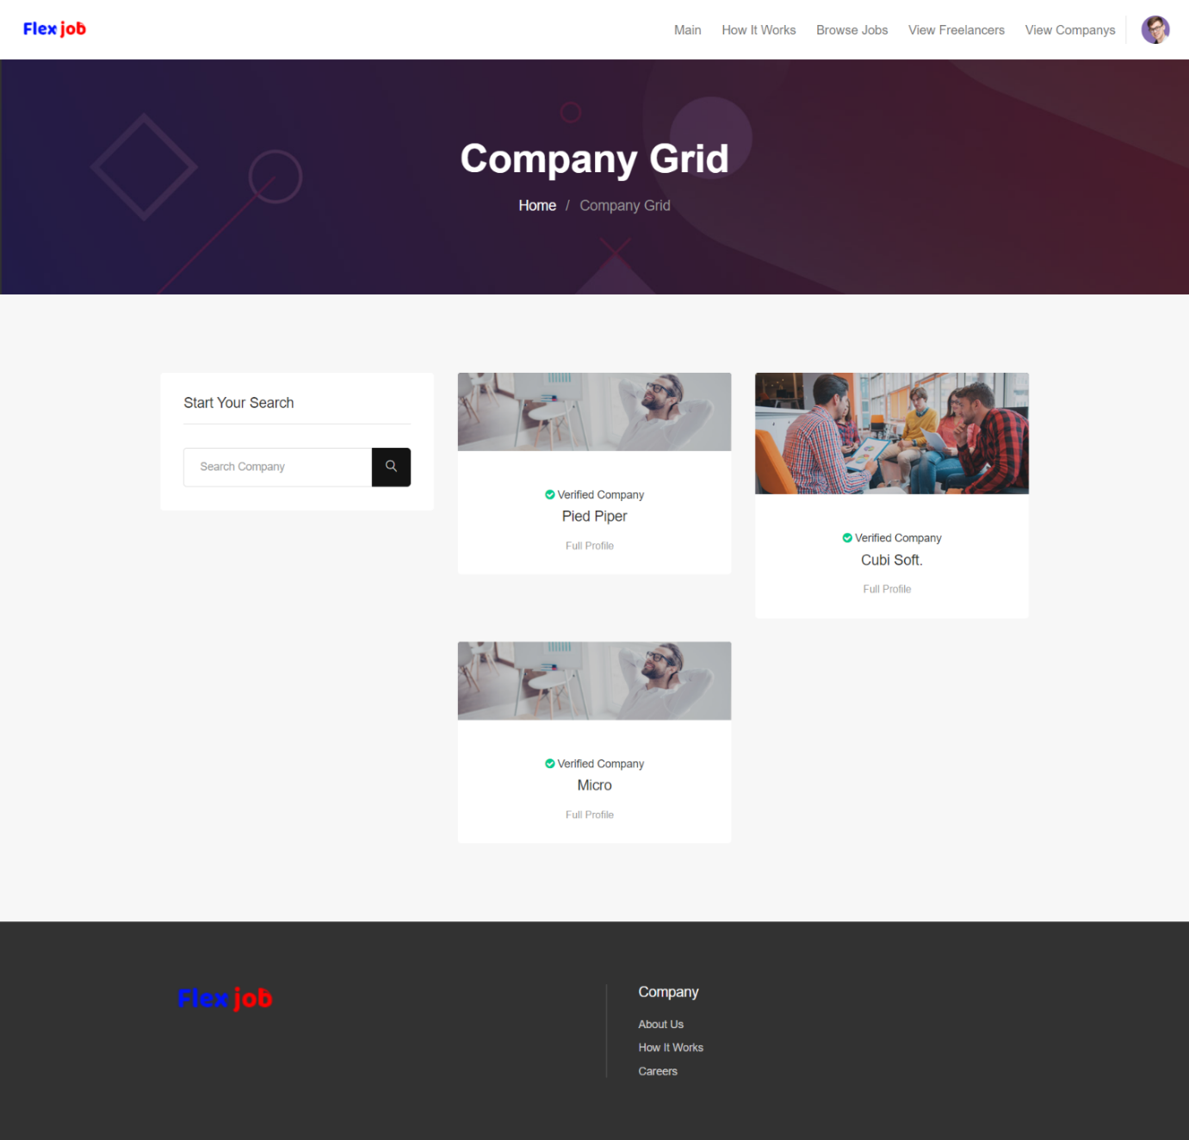
Company Grid

Slide 18
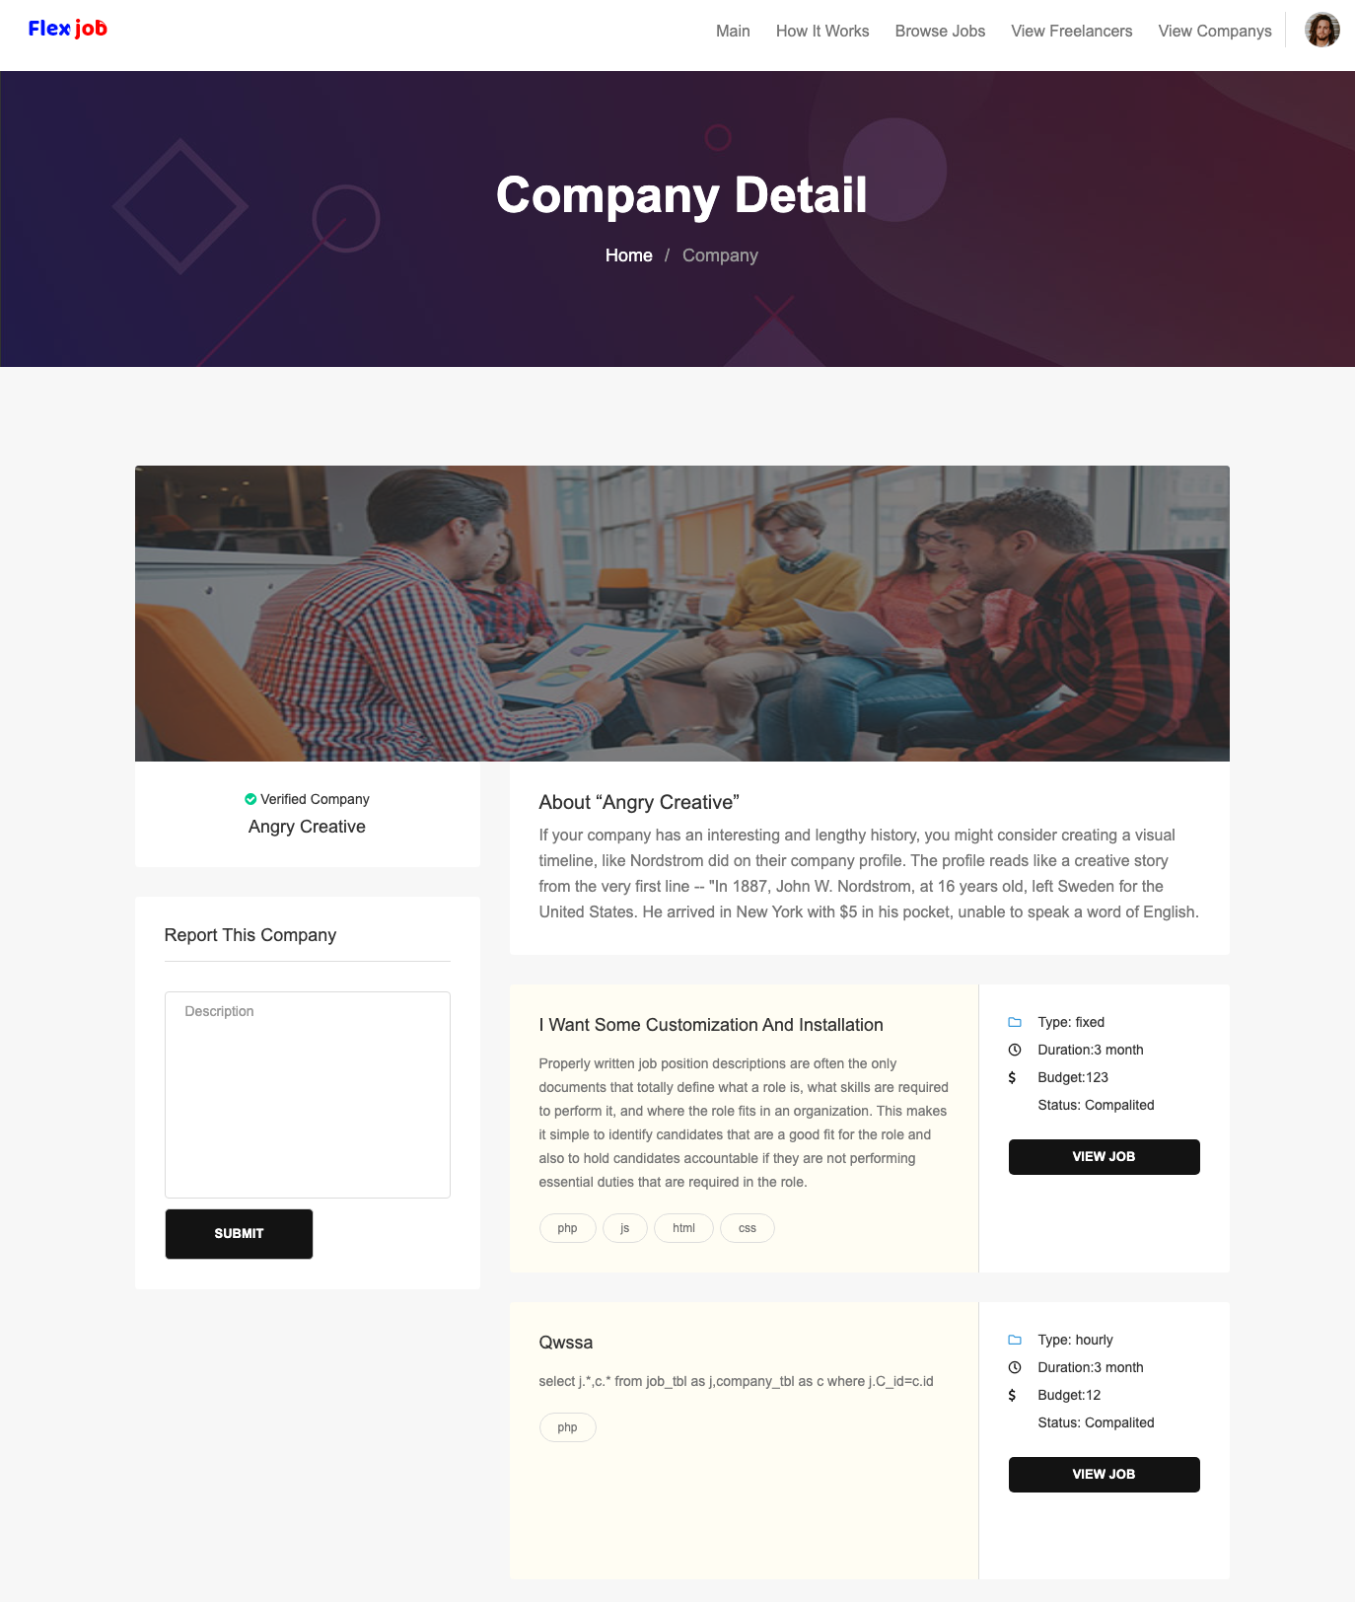
Company Details

Slide 19
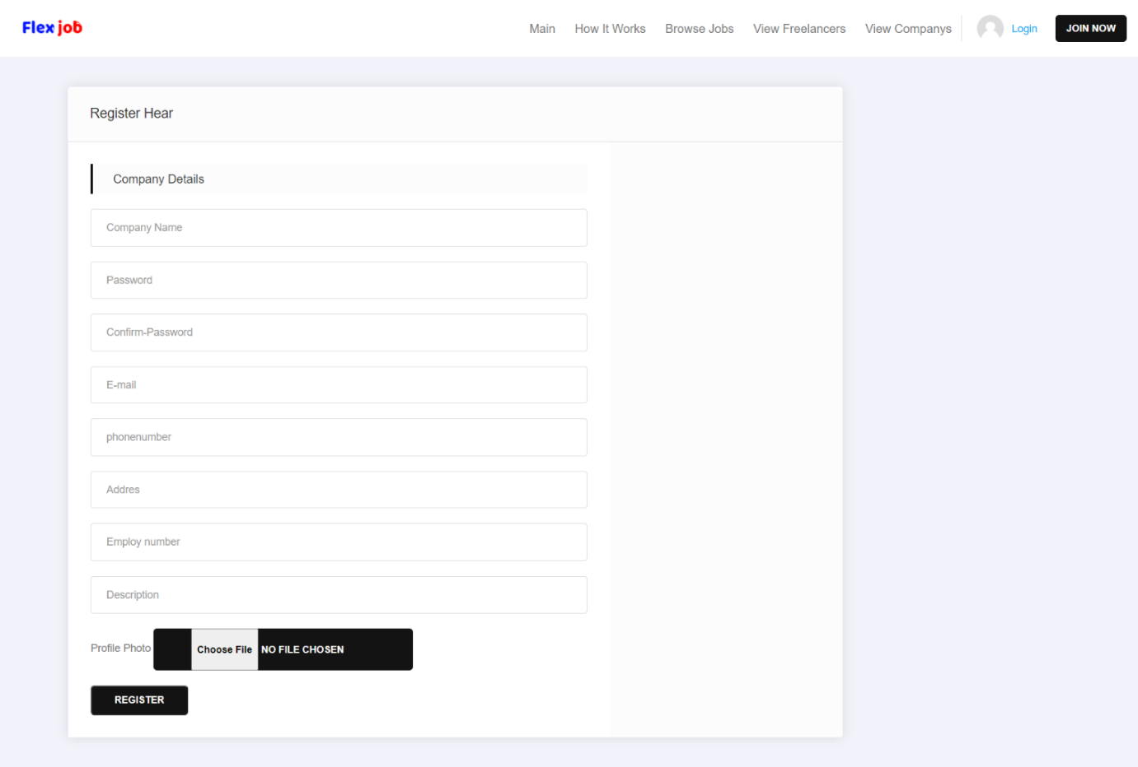
Company Registration

Slide 20
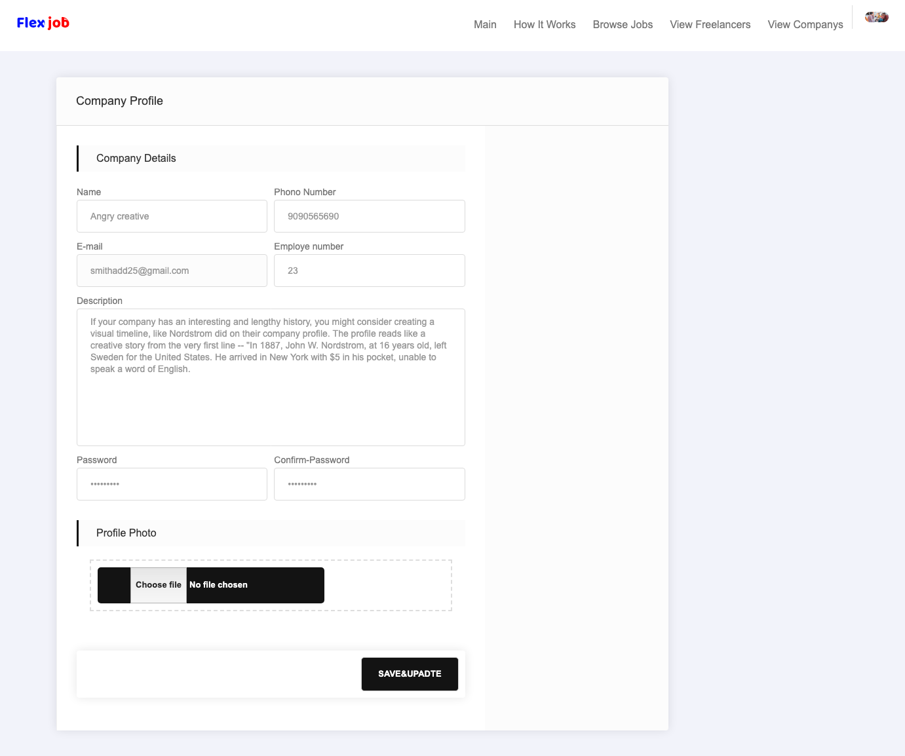
Company
Profile setting

Slide 21
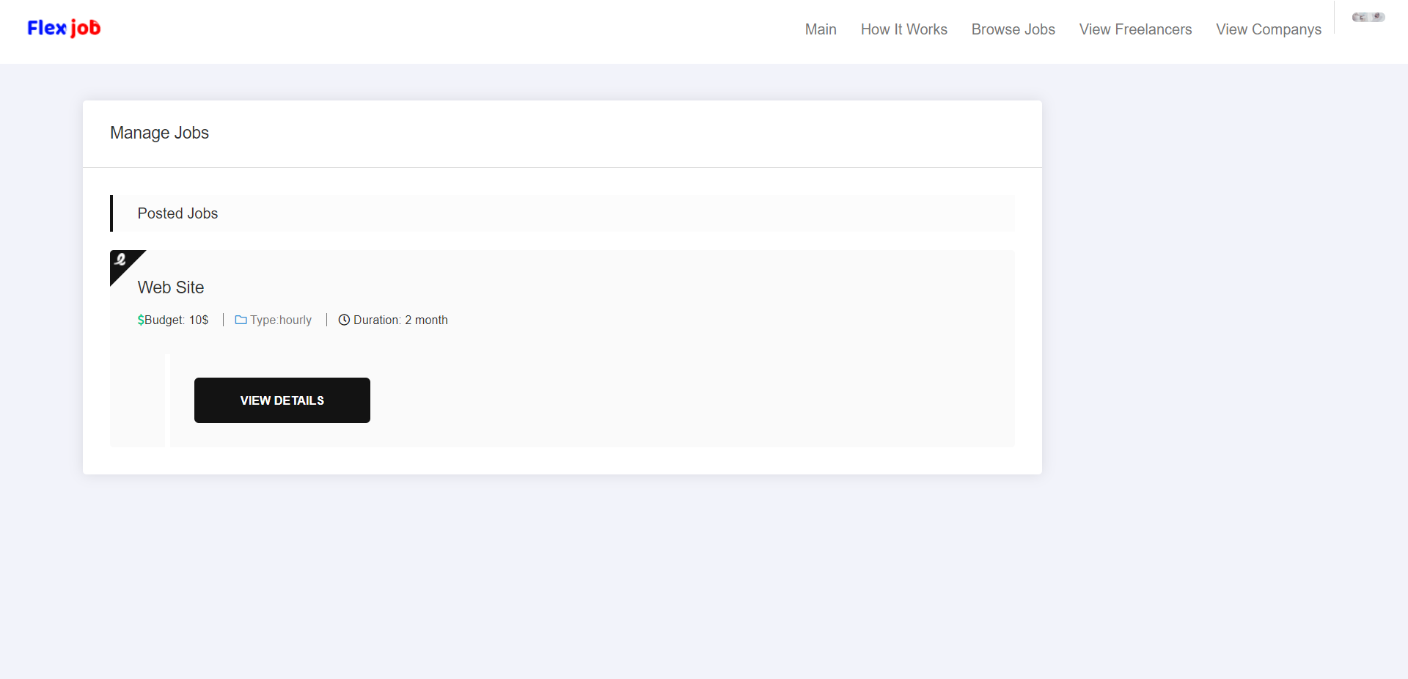
Manage Jobs

Slide 22
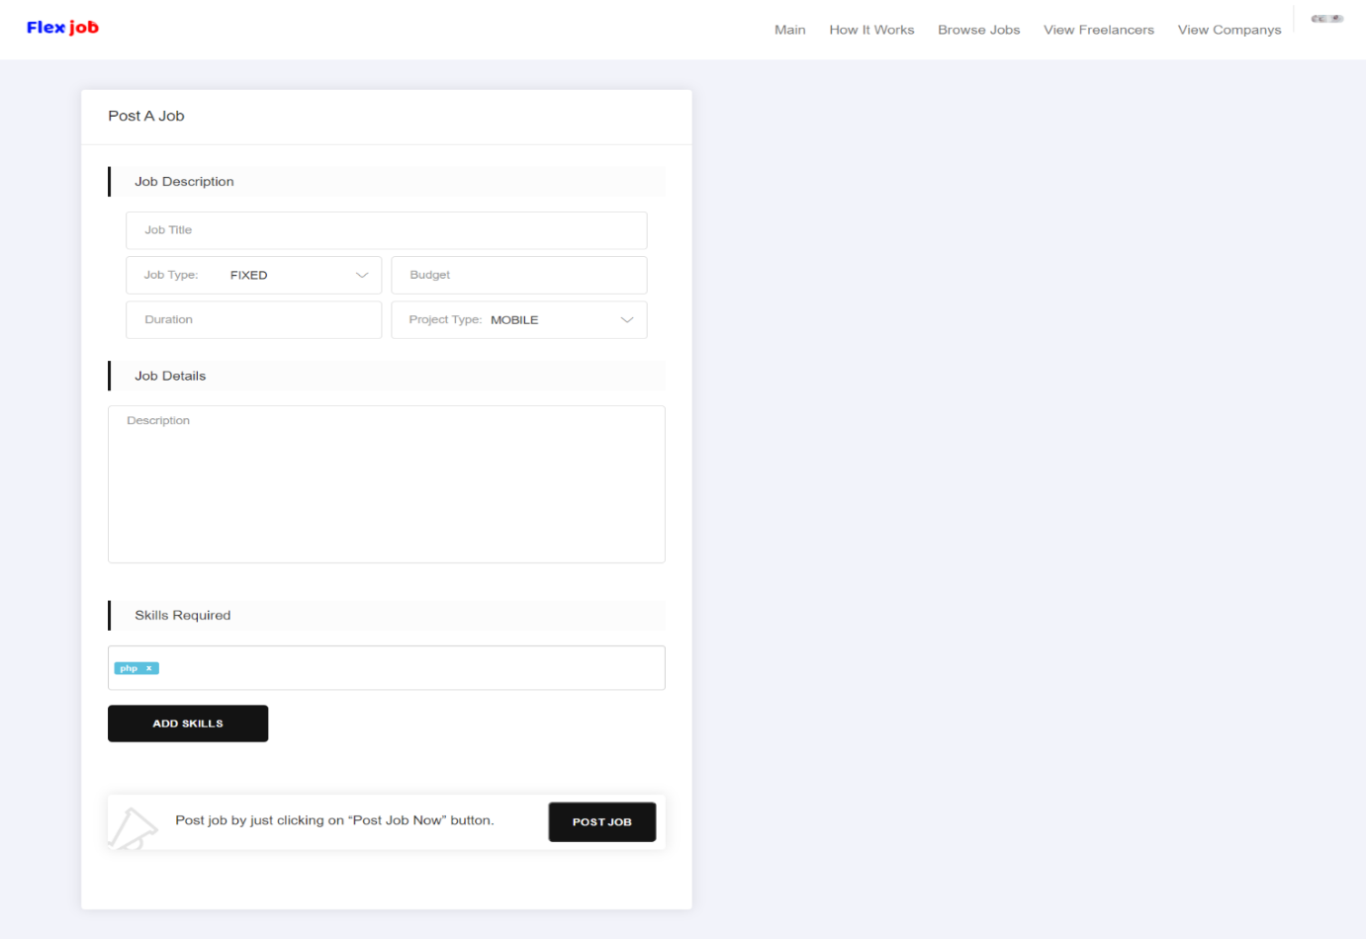
Post Job

Slide 23
Limitations of the project:
In our website we are not provide online chatting system.
No payment transaction between user and company.
User can not upload their resume in profile.

Slide 24
Project Outcomes
The scope of the website FlexJob is global or should be able to be accessed from anywhere through internet. Company or Freelancer can access website anywhere any time when they want.
We hope this type of FlexJob will yield to certain benefits to customer. We have tried our best to illustrate some of them.
The side must be user friendly and graphics must be used to give a striking look and feel of any services of item. The side must be easy and flexible to use.
Navigate must be smoother and user must be able to understand the links.

Slide 25
7. Reference
https://www.w3schools.com/bootstrap4/default.asp
https://www.w3schools.com/js/default.asp
https://www.w3schools.com/php/default.asp
https://www.w3schools.com/css/default.asp
https://www.youtube.com/watch?v=OK_JCtrrv-c
https://www.youtube.com/watch?v=1Rs2ND1ryYc
https://www.youtube.com/watch?v=F_4YkYUZP_Q

Slide 26
Thank You

